Slide 1
Sales Wear Group
Yusuf Gamal

Slide 2
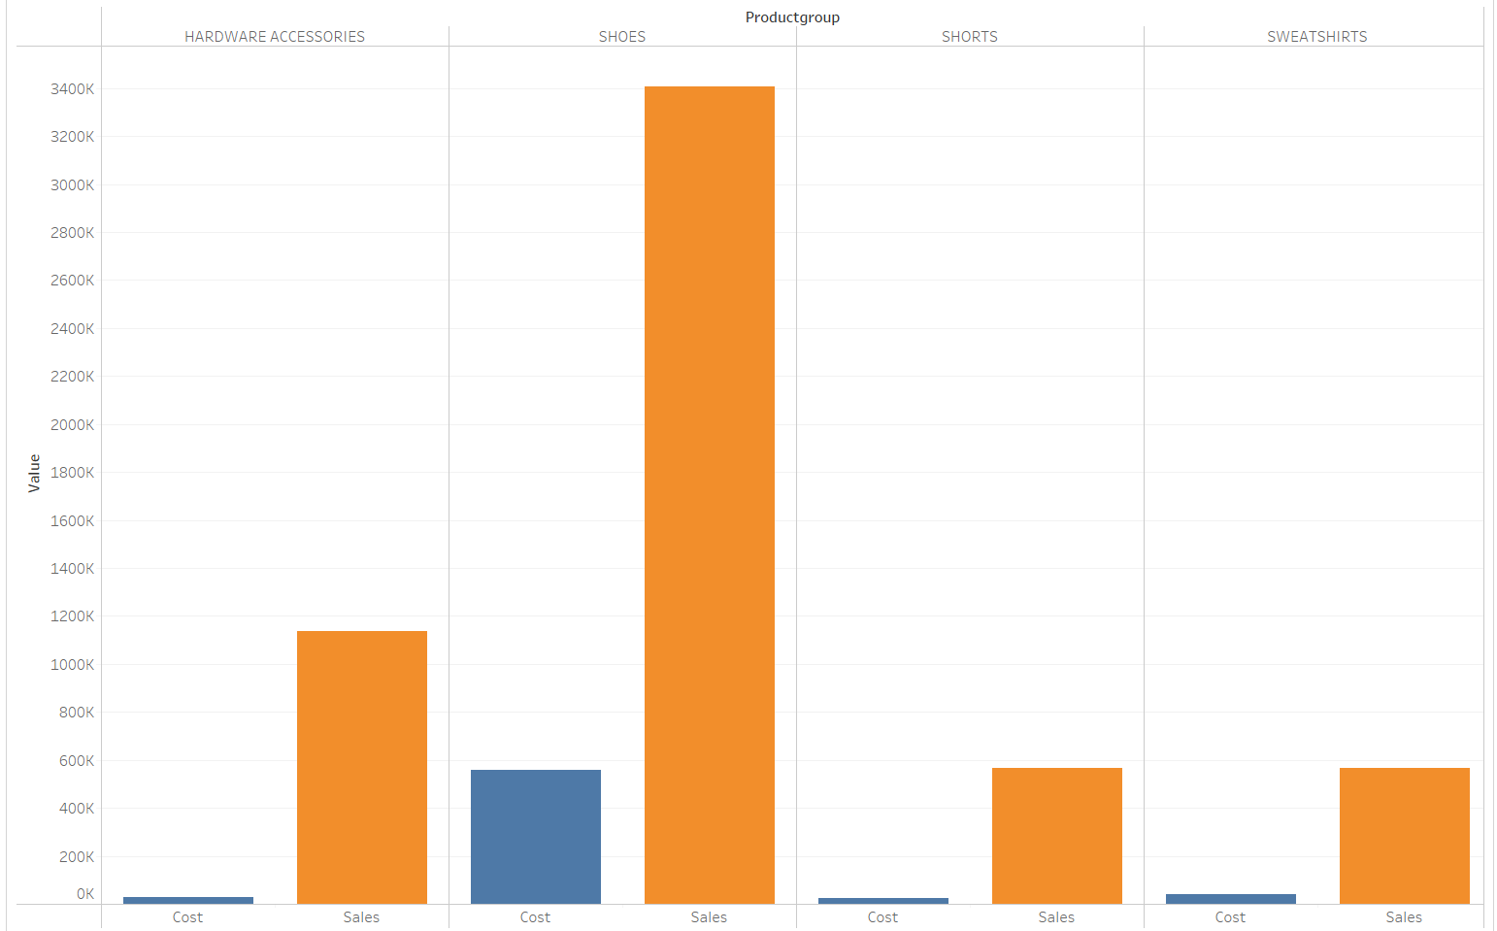
Cost And Sales For Each Product

Slide 3
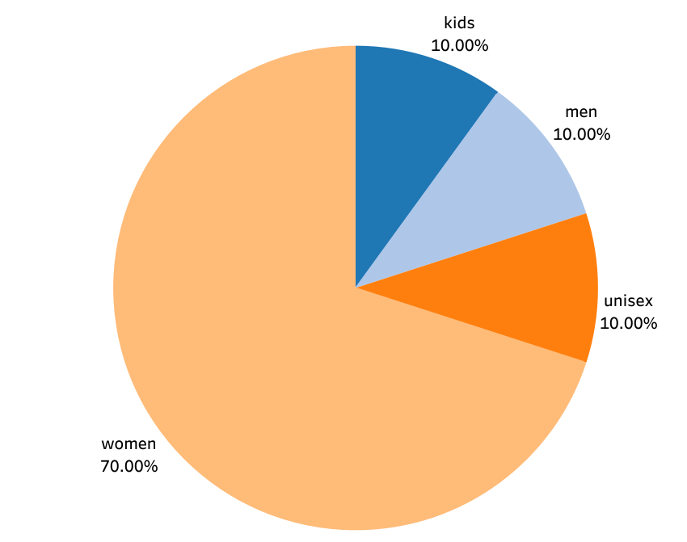
Percentage Of total Sales For Gender
Women have 60.00 % of sales :
30% from Shoes
20% from Hardware Accessories
10% from shorts
10% from sweatshirts
Men , Kids and unisex 30.00%
All From Shoes

Slide 4
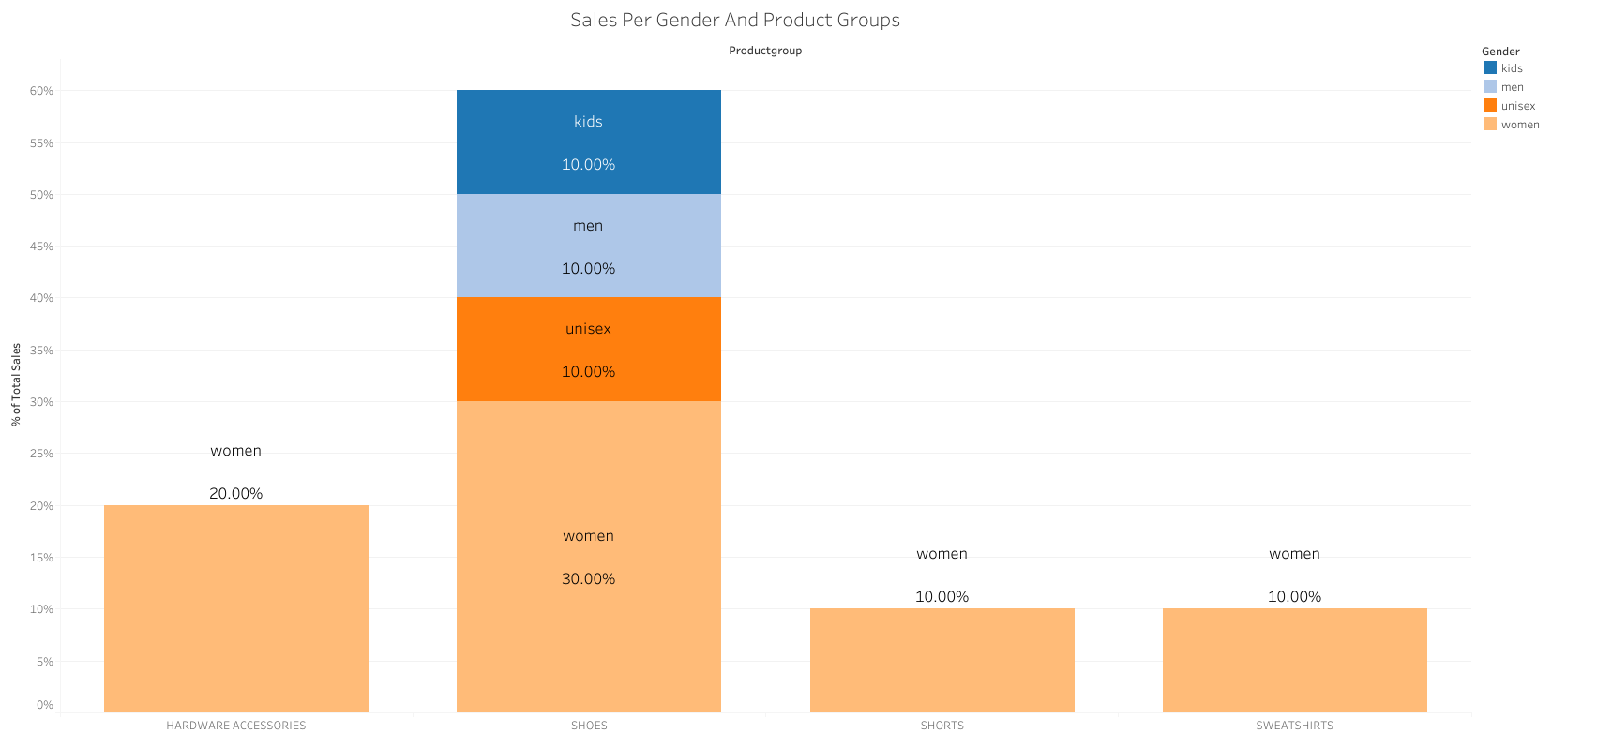
Sales Percentage Per Gender And Product Groups

Slide 5
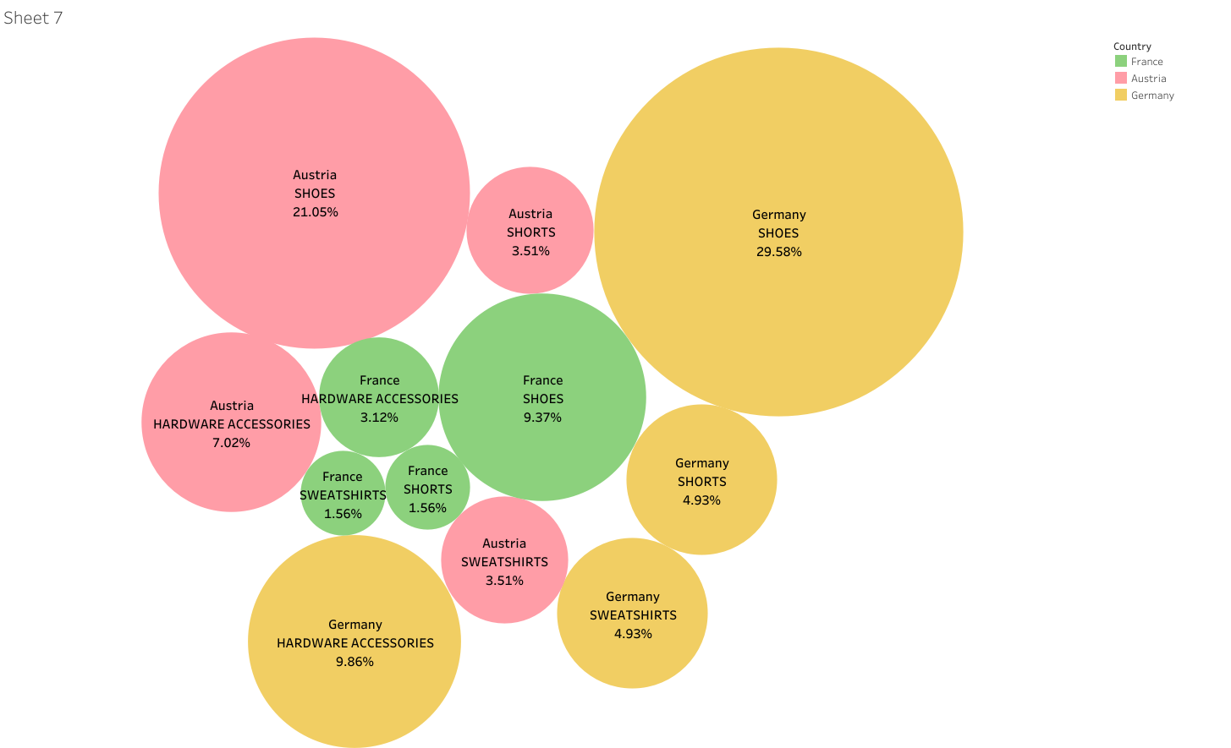
Country Product Group Percentage of Total Sales
Germany has 49.30 %
2,799,120 E
Austria has 35.09 %
1,922,300 E
Germany has 15.62 %
886,760 E

Slide 6
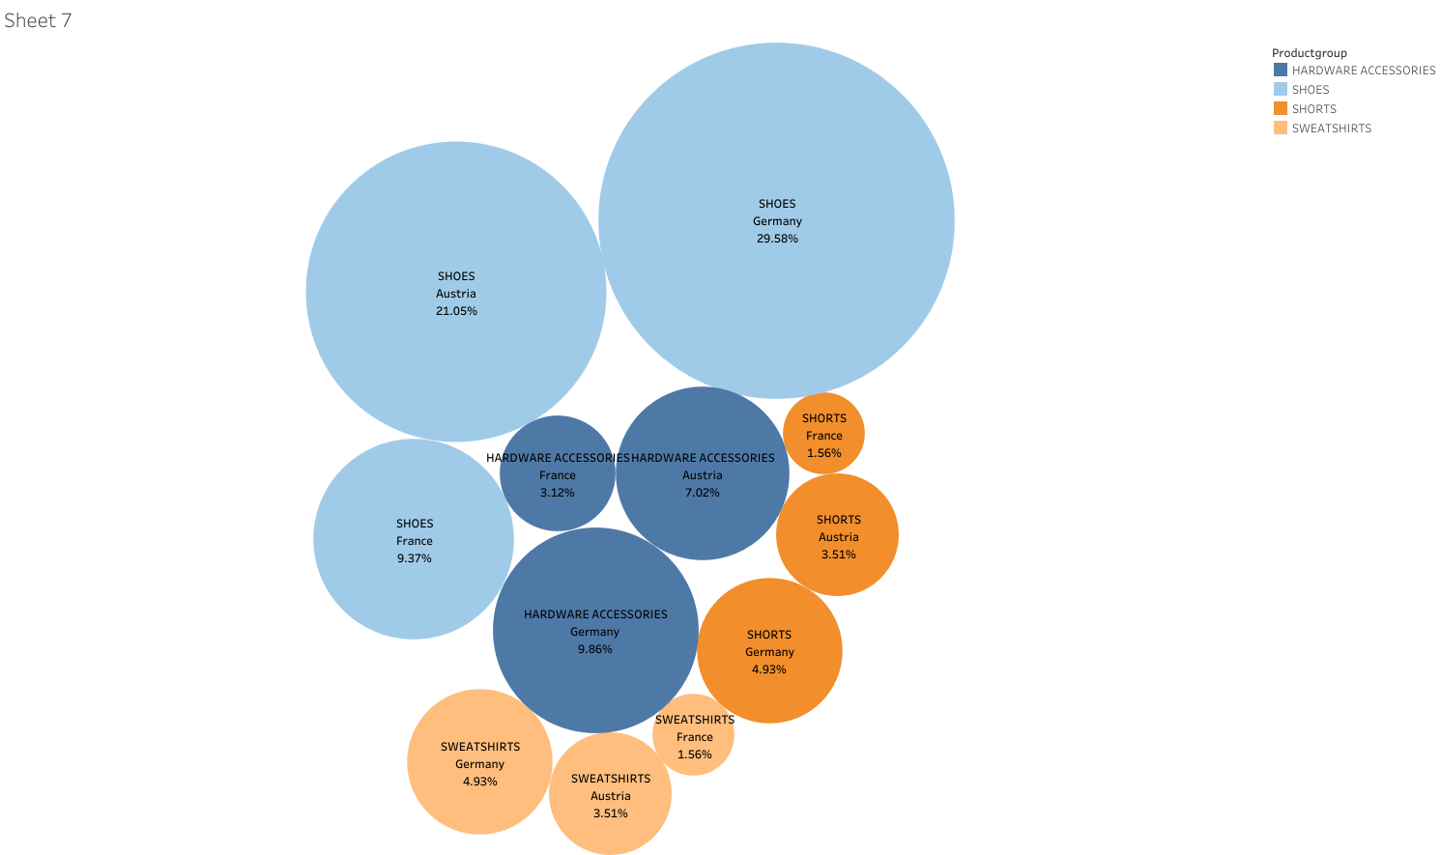
Country Product Group Percentage of Total Sales
Shoes 60.00 %
29.85% at Germany
21.05% at Austria
9.37% at France
Hardware Accessories 20 %
9.86% at Germany
7.02% at Austria
3.12% at France
Sweet Shirts - Shorts 10 %
4.93% at Germany
3.51% at Austria
1.56% at France

Slide 7
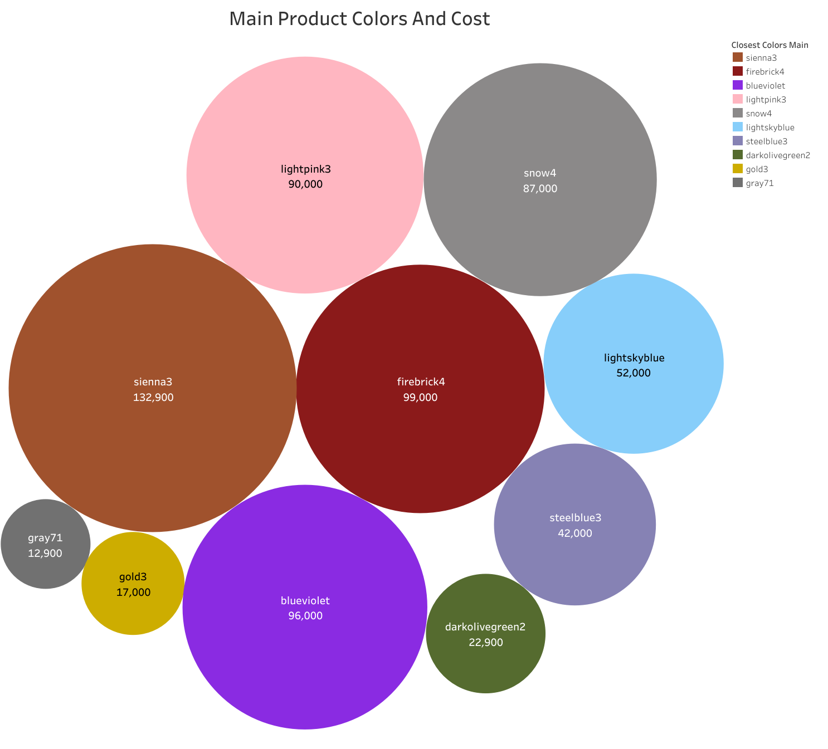
Main Products Colours With Their Cost
Product Colours affects the total cost
They vary a lot in production causes gap in sales and decreases the profit
Reduce the production of high cost colours and increase the production of low cost colours

Slide 8
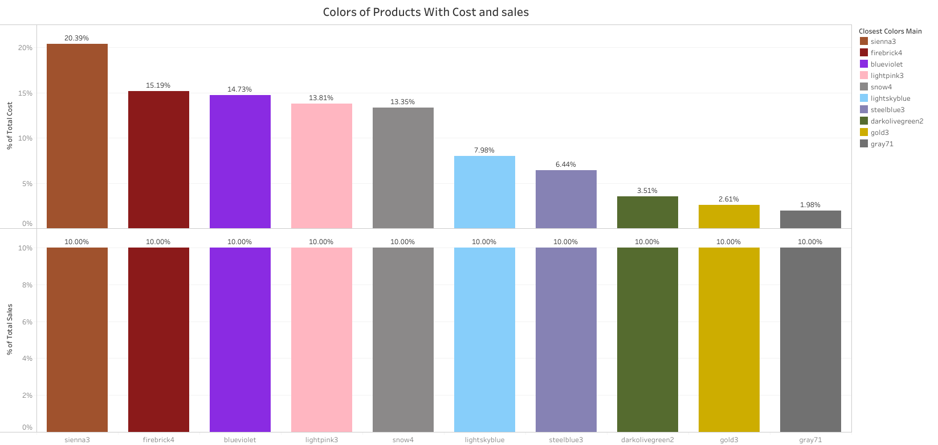
Colours Of Product With Cost and Sales Percentage

Slide 9
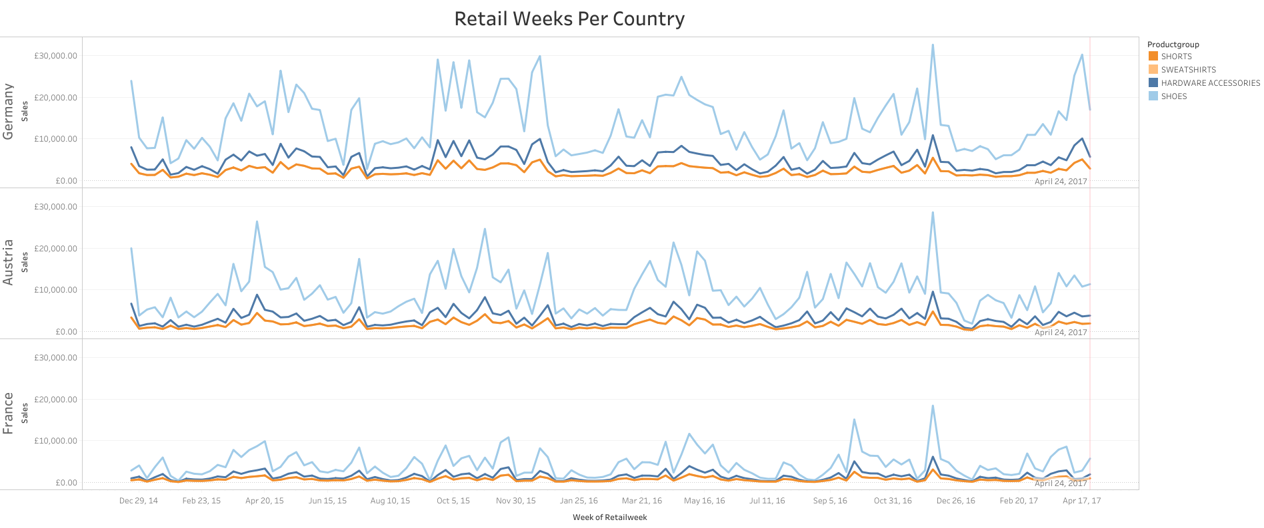
Retail Weeks For each product group

Slide 10
Retail Weeks For each product group
Shoes are the most common products in 3 countries
Sales increases in holidays (Christmas, etc) at each country for each product

